Slide 1
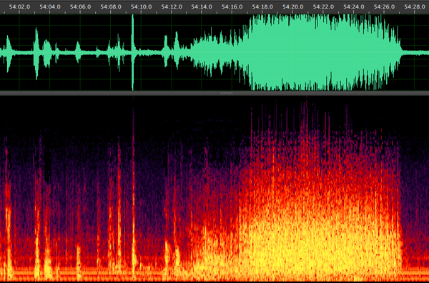
Applause and Interaction in the
PennSound Poetry Archive
Reading by Charles Olson, Vancouver Poetry Conference, 1963
Stephen McLaughlin
UT Austin School of Information

Slide 2
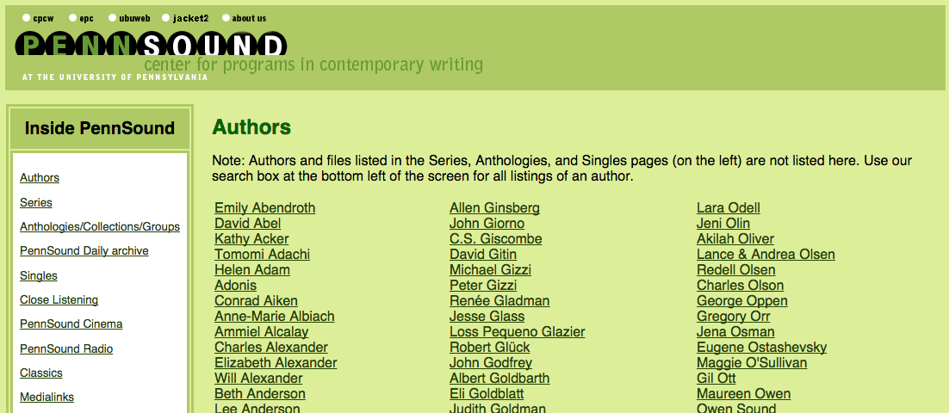
PennSound
~36,000 audio files
~625 poets
~3,500 distinct public readings

Slide 3
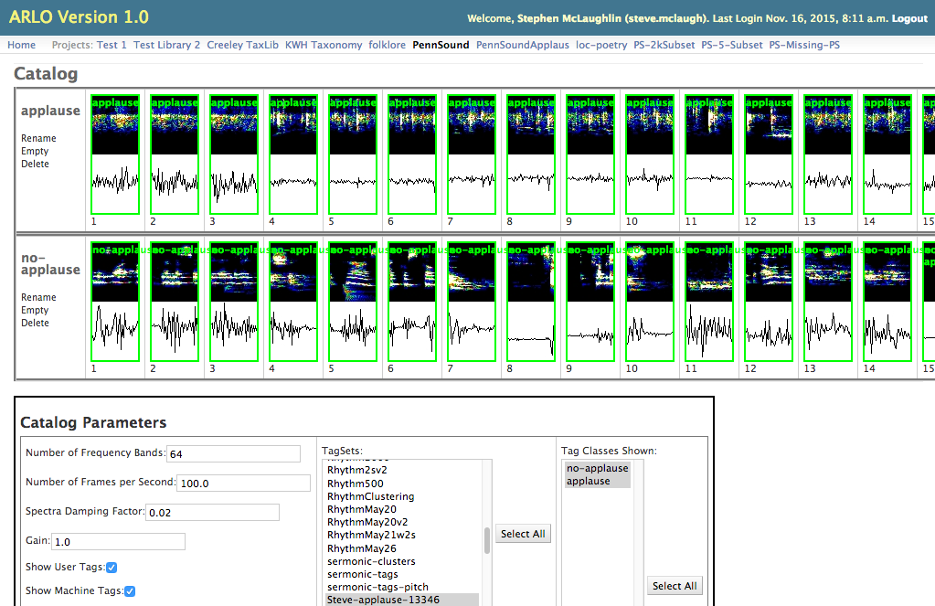

Slide 4
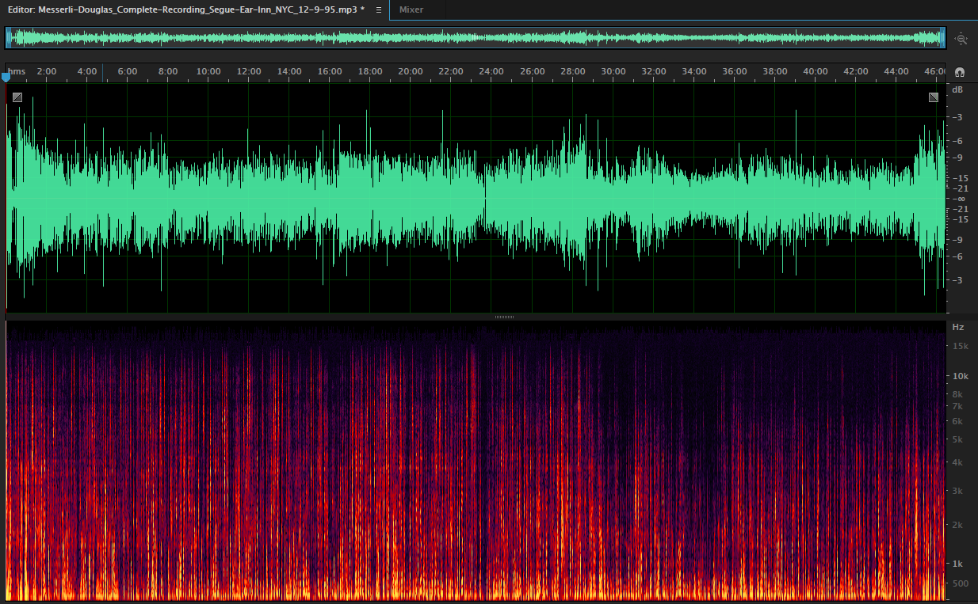
Where’s the applause?
Notes:
Practical: metadata

Slide 5
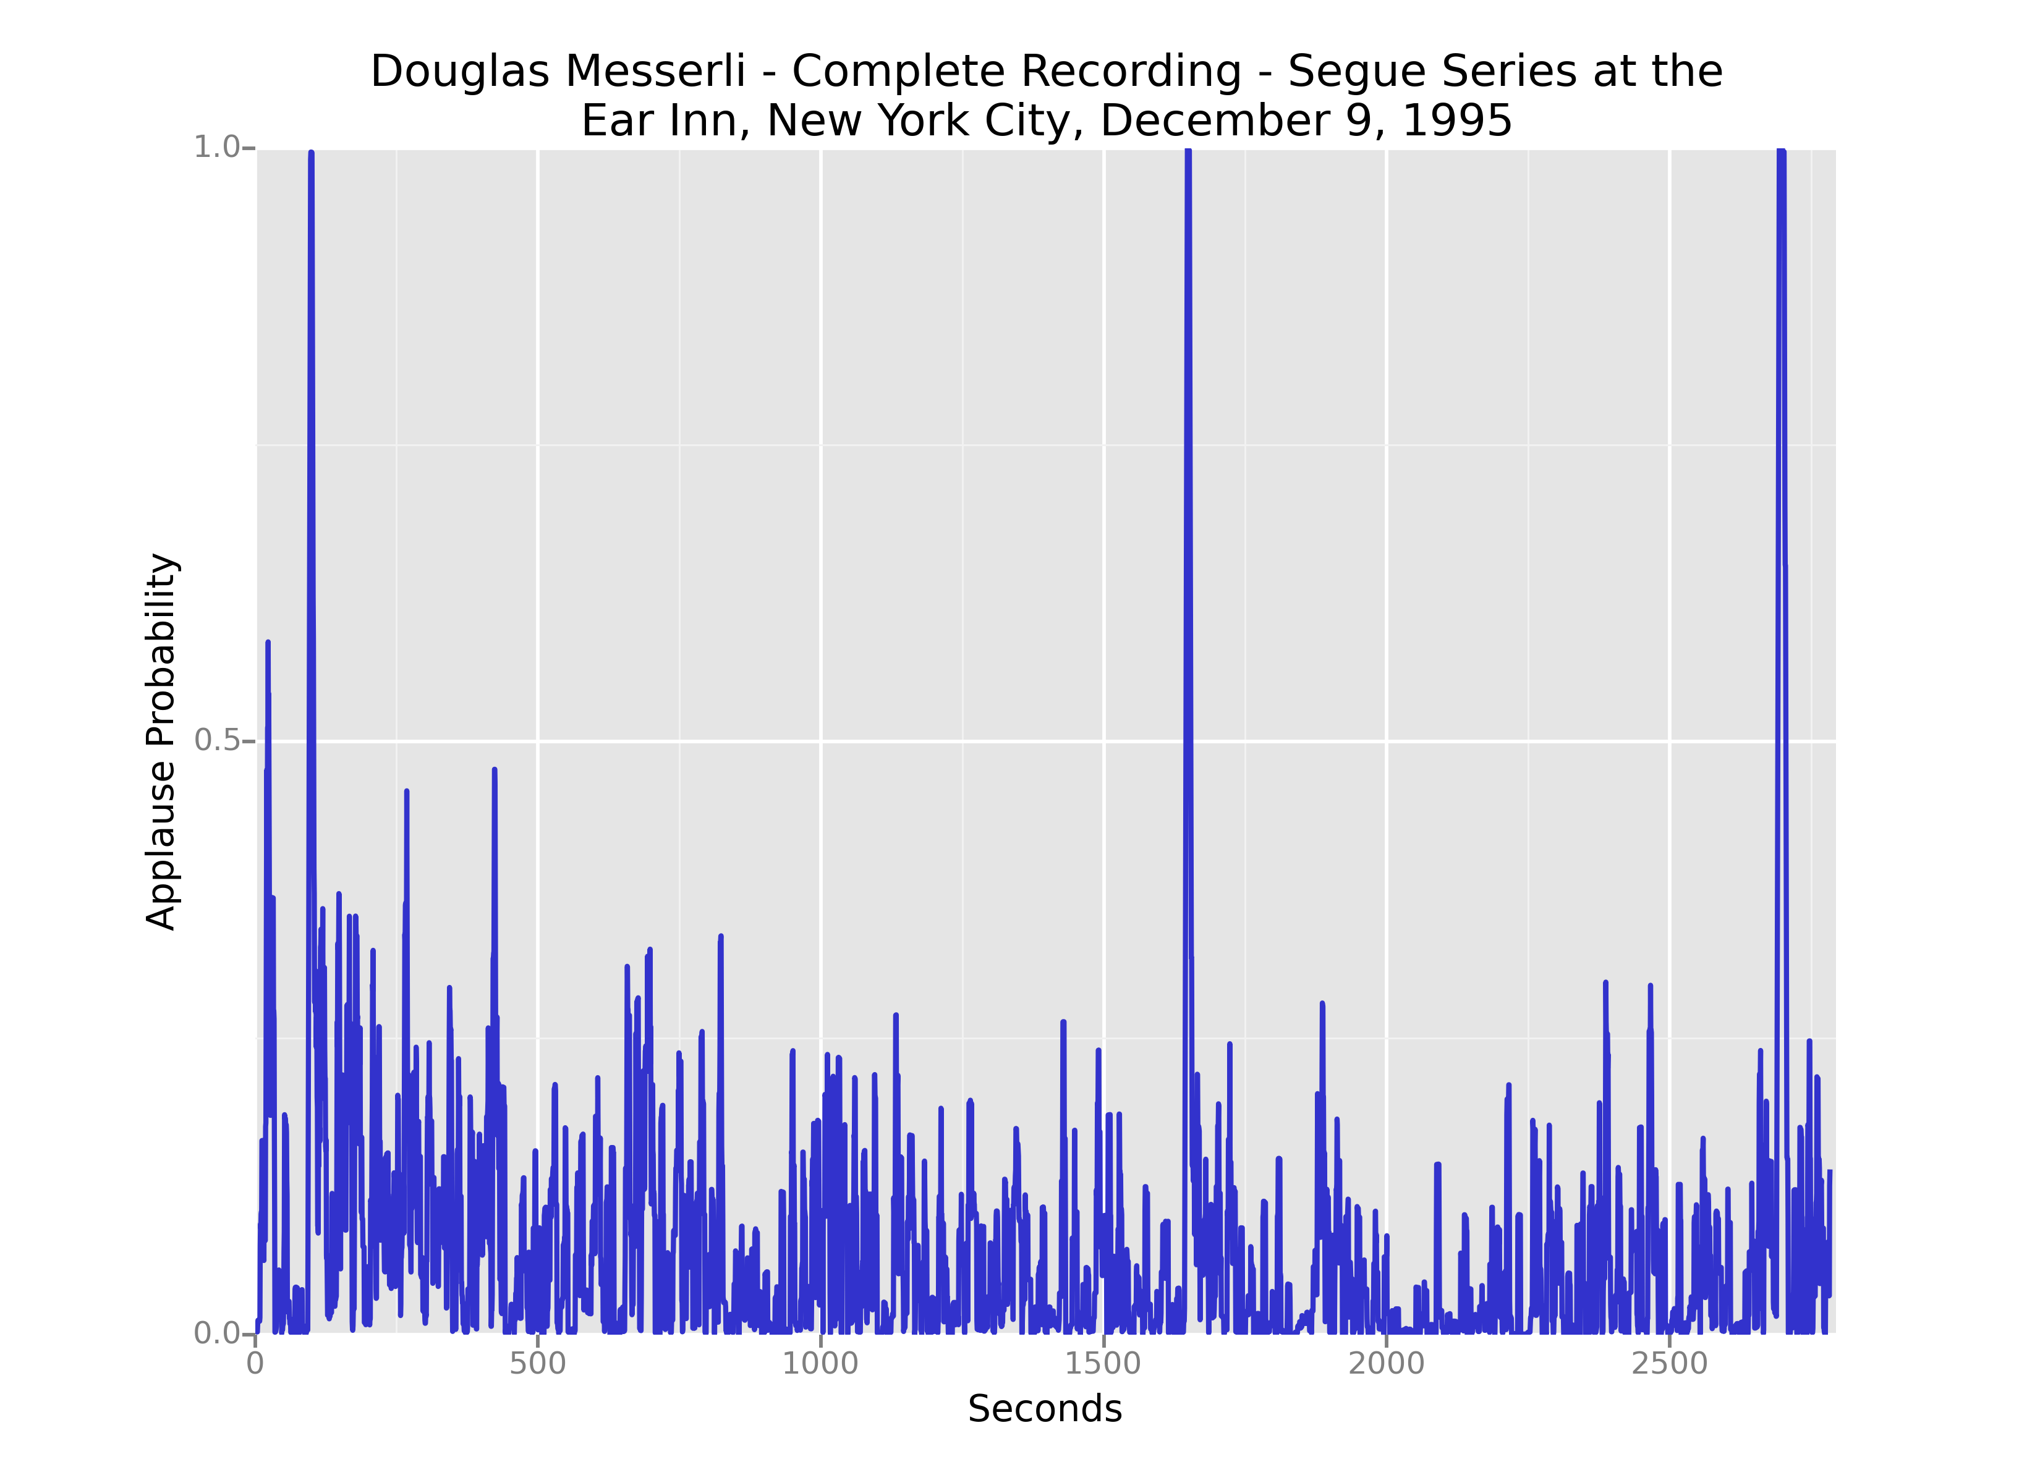

Slide 6
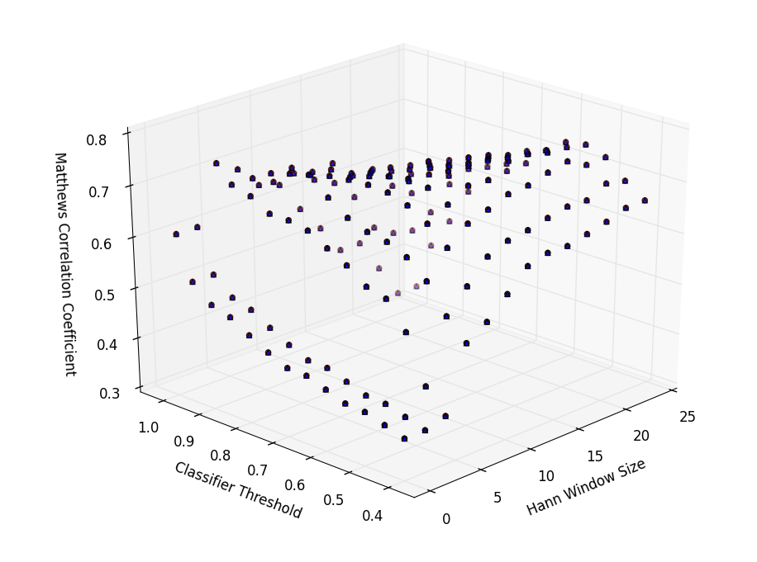
Validation and Optimization

Slide 7
The Distant Reading Approach

Slide 8
The Interactionist Approach
106 randomly chosen readings examined by hand
Opening and closing applause measured; interstitial applause coded
Aim: analysis of “background expectancies” (Garfinkel 1991) and “sequencing rules” (Sacks 1992)

Slide 9
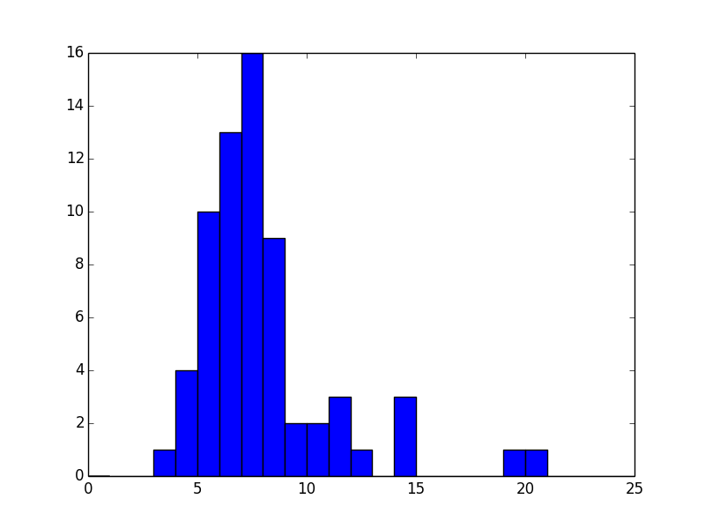
Opening Applause
Number of instances
Applause length (seconds)

Slide 10
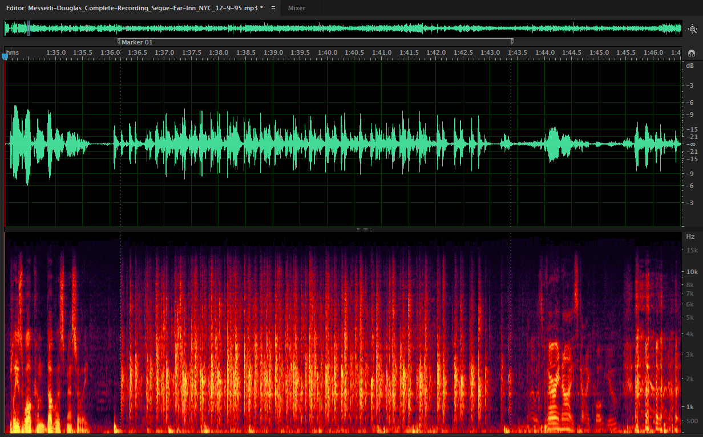

Opening Applause
Clear cue, coordinated start

Slide 11
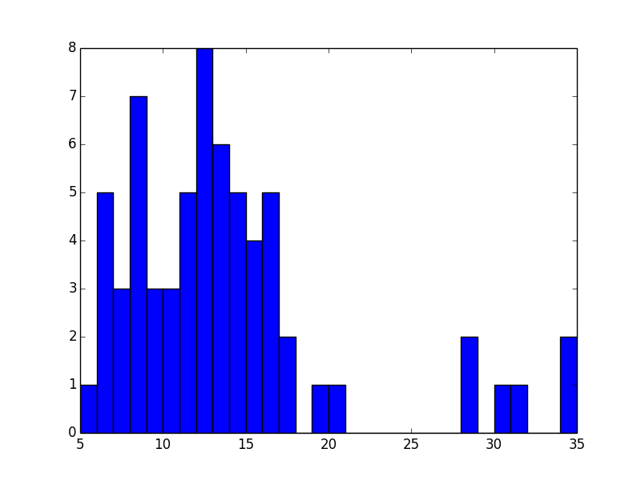
Closing Applause
Number of instances
Applause length (seconds)

Slide 12
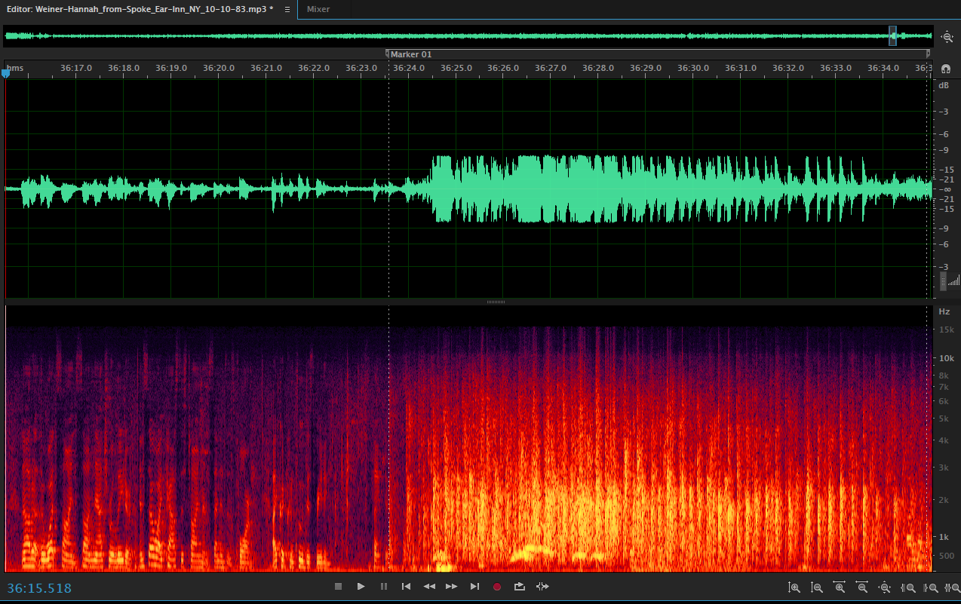
Closing Applause
Clear cue, slightly staggered start

Slide 13
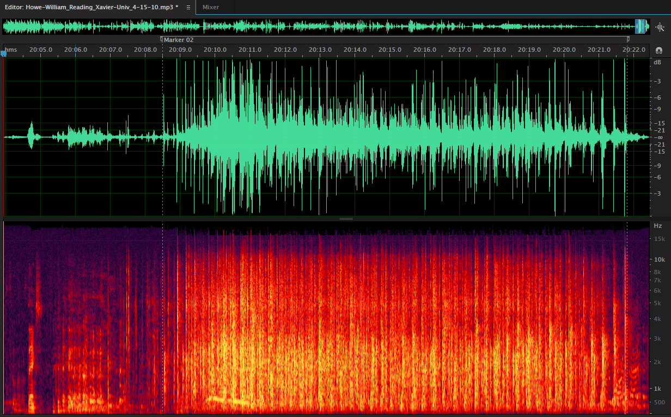
Closing Applause
Vocalization following start of applause

Slide 14
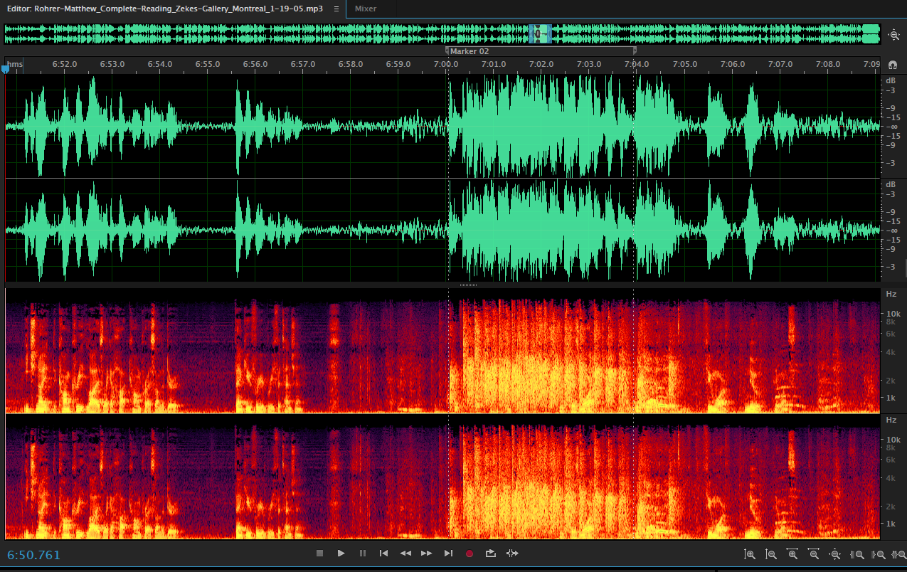
Closing Applause
Audience misinterpretation

Slide 15
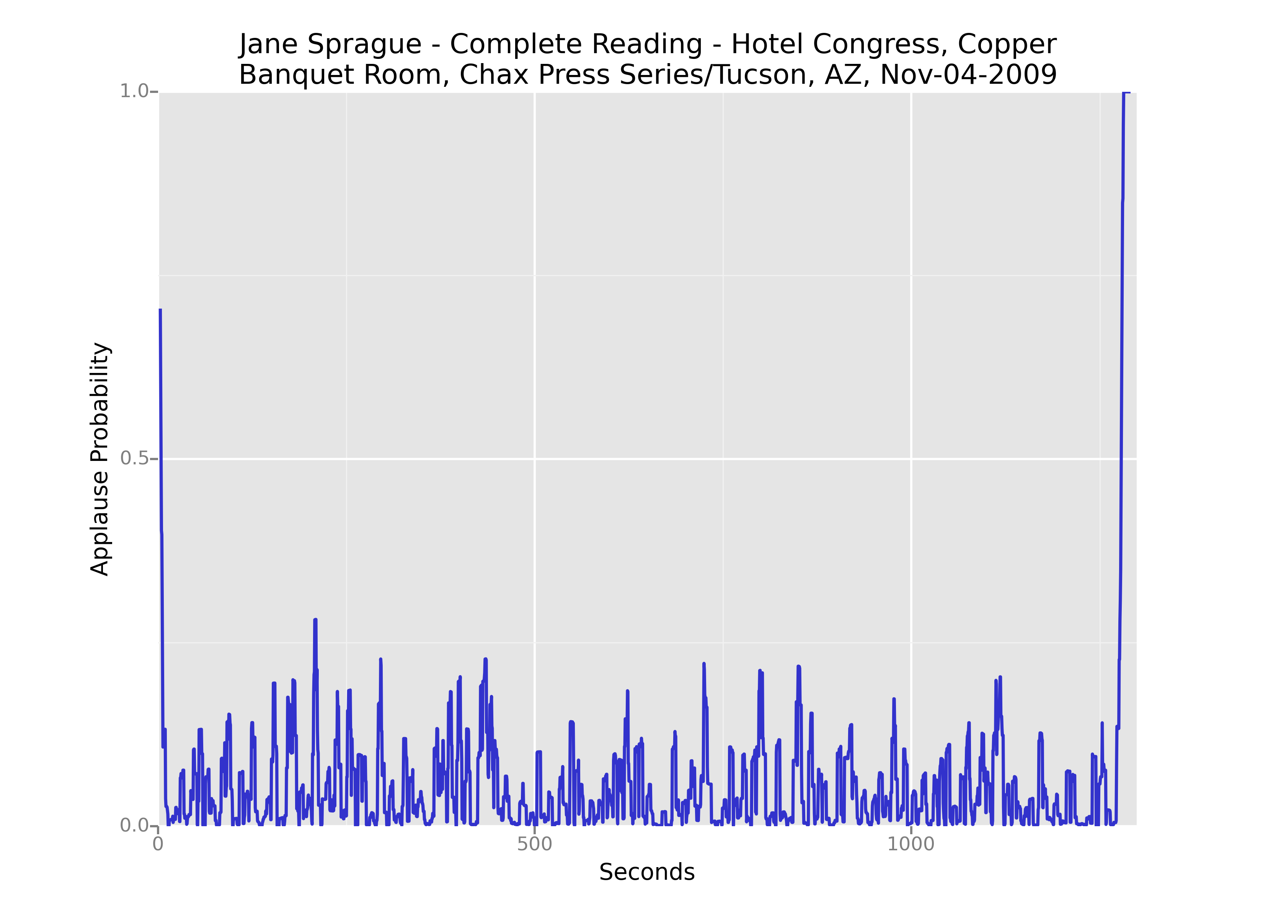
Opening/Closing Pair

Slide 16
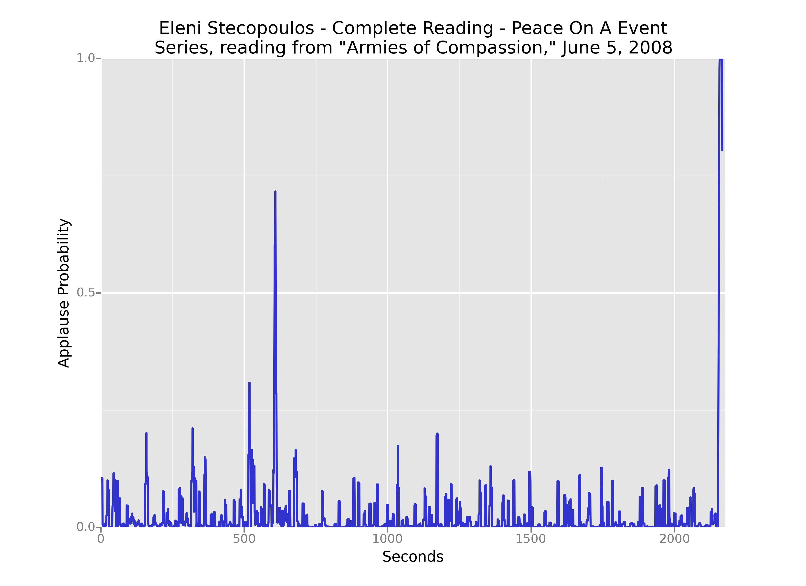
Opening/Closing Pair

Slide 17
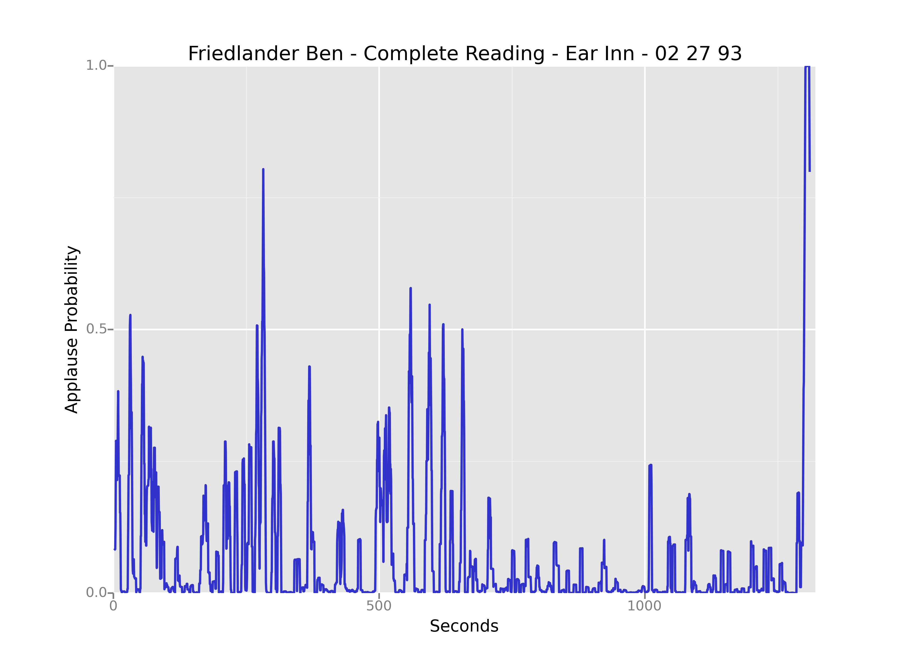
Opening/Closing Pair

Slide 18
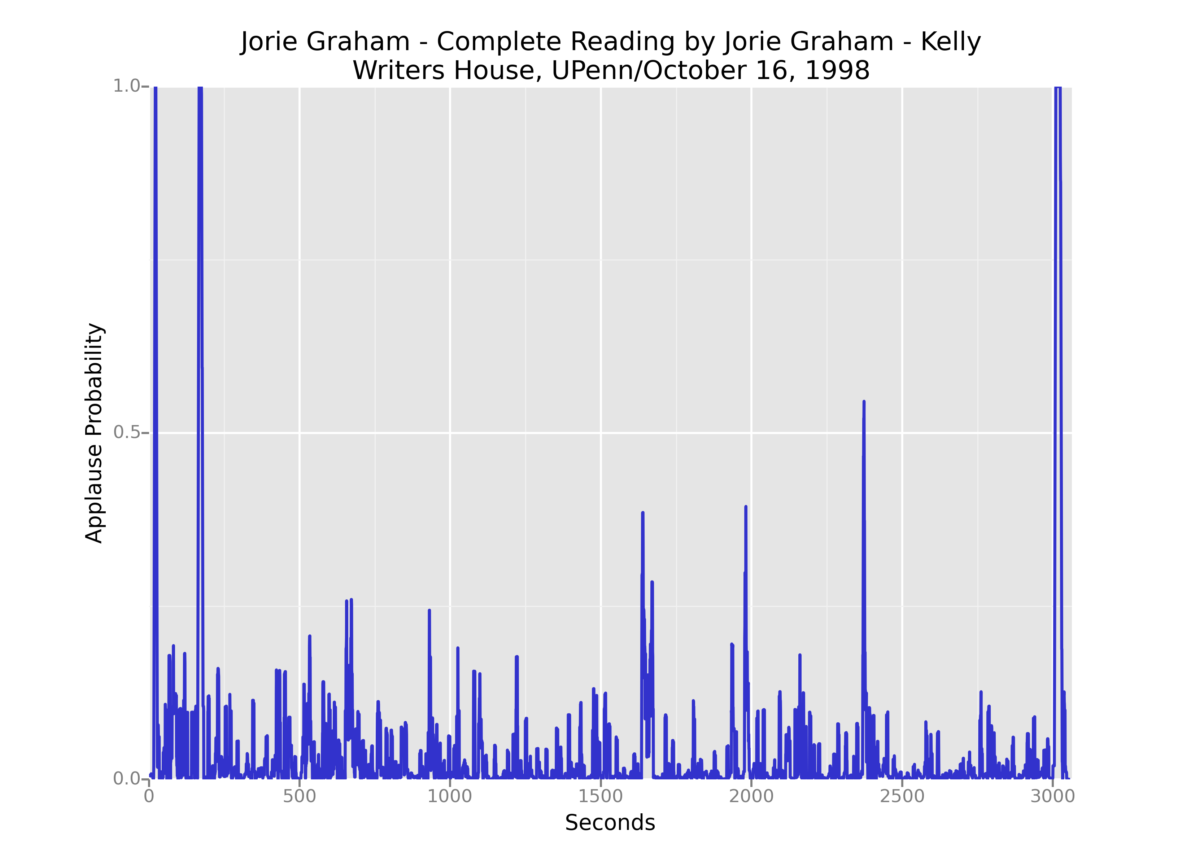
Opening/Closing Pair

Slide 19
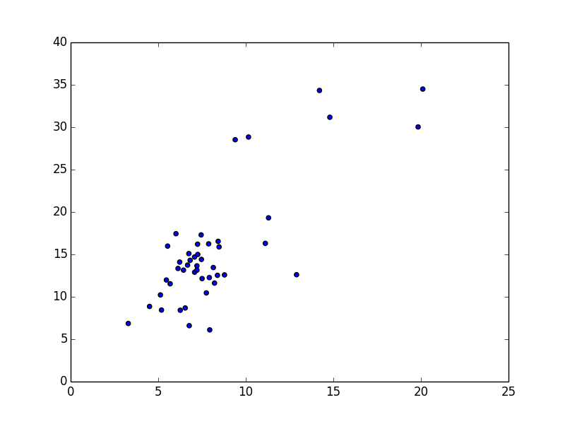
Opening/Closing Pair
Closing applause duration (seconds)
Opening applause duration (seconds)

Slide 20
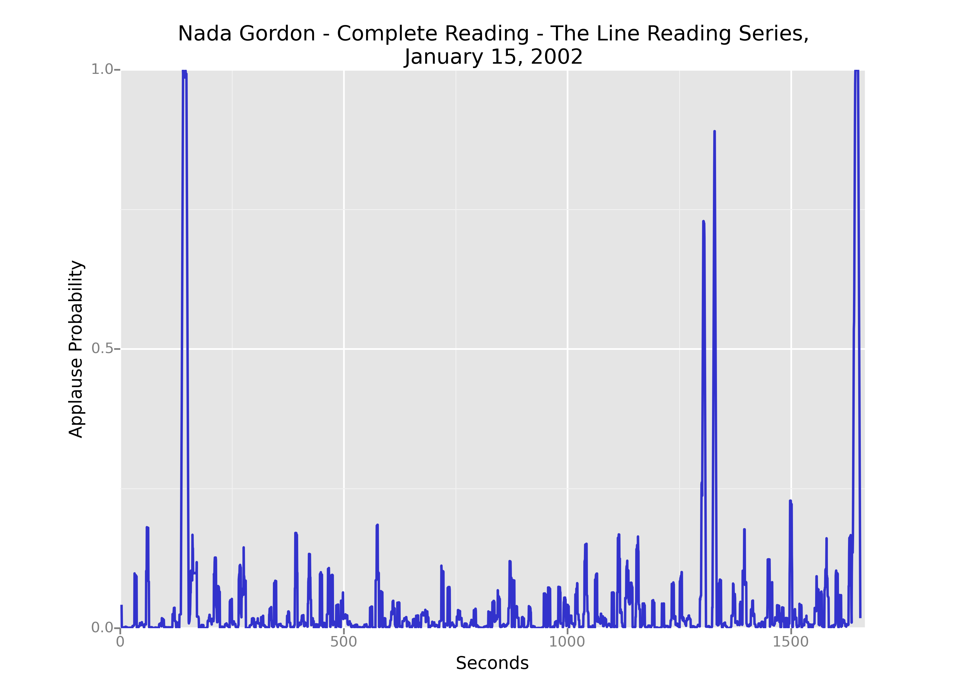
Interstitial Applause
Collaborator introduction

Slide 21
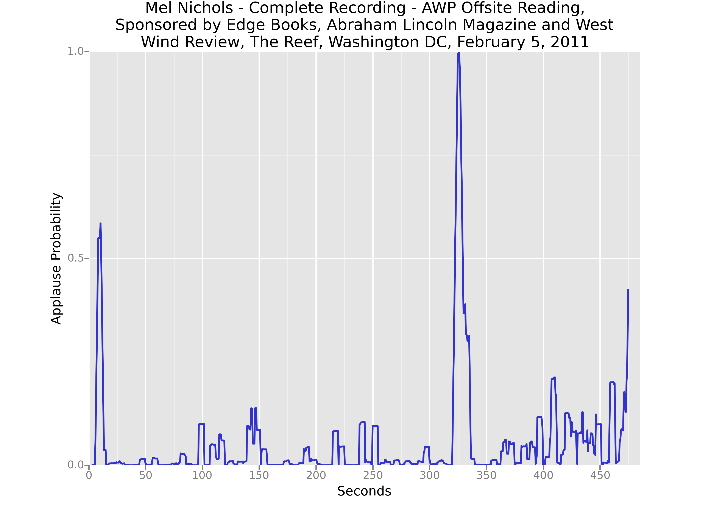
Interstitial Applause
Organizer acknowledgment

Slide 22
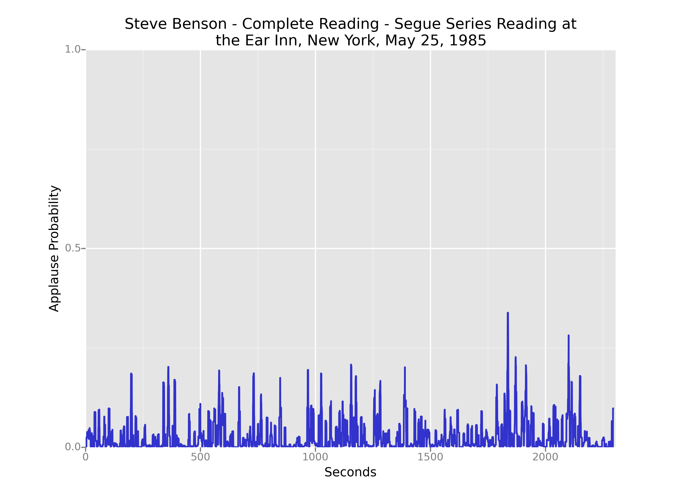
Interstitial Applause
No poem breaks

Slide 23
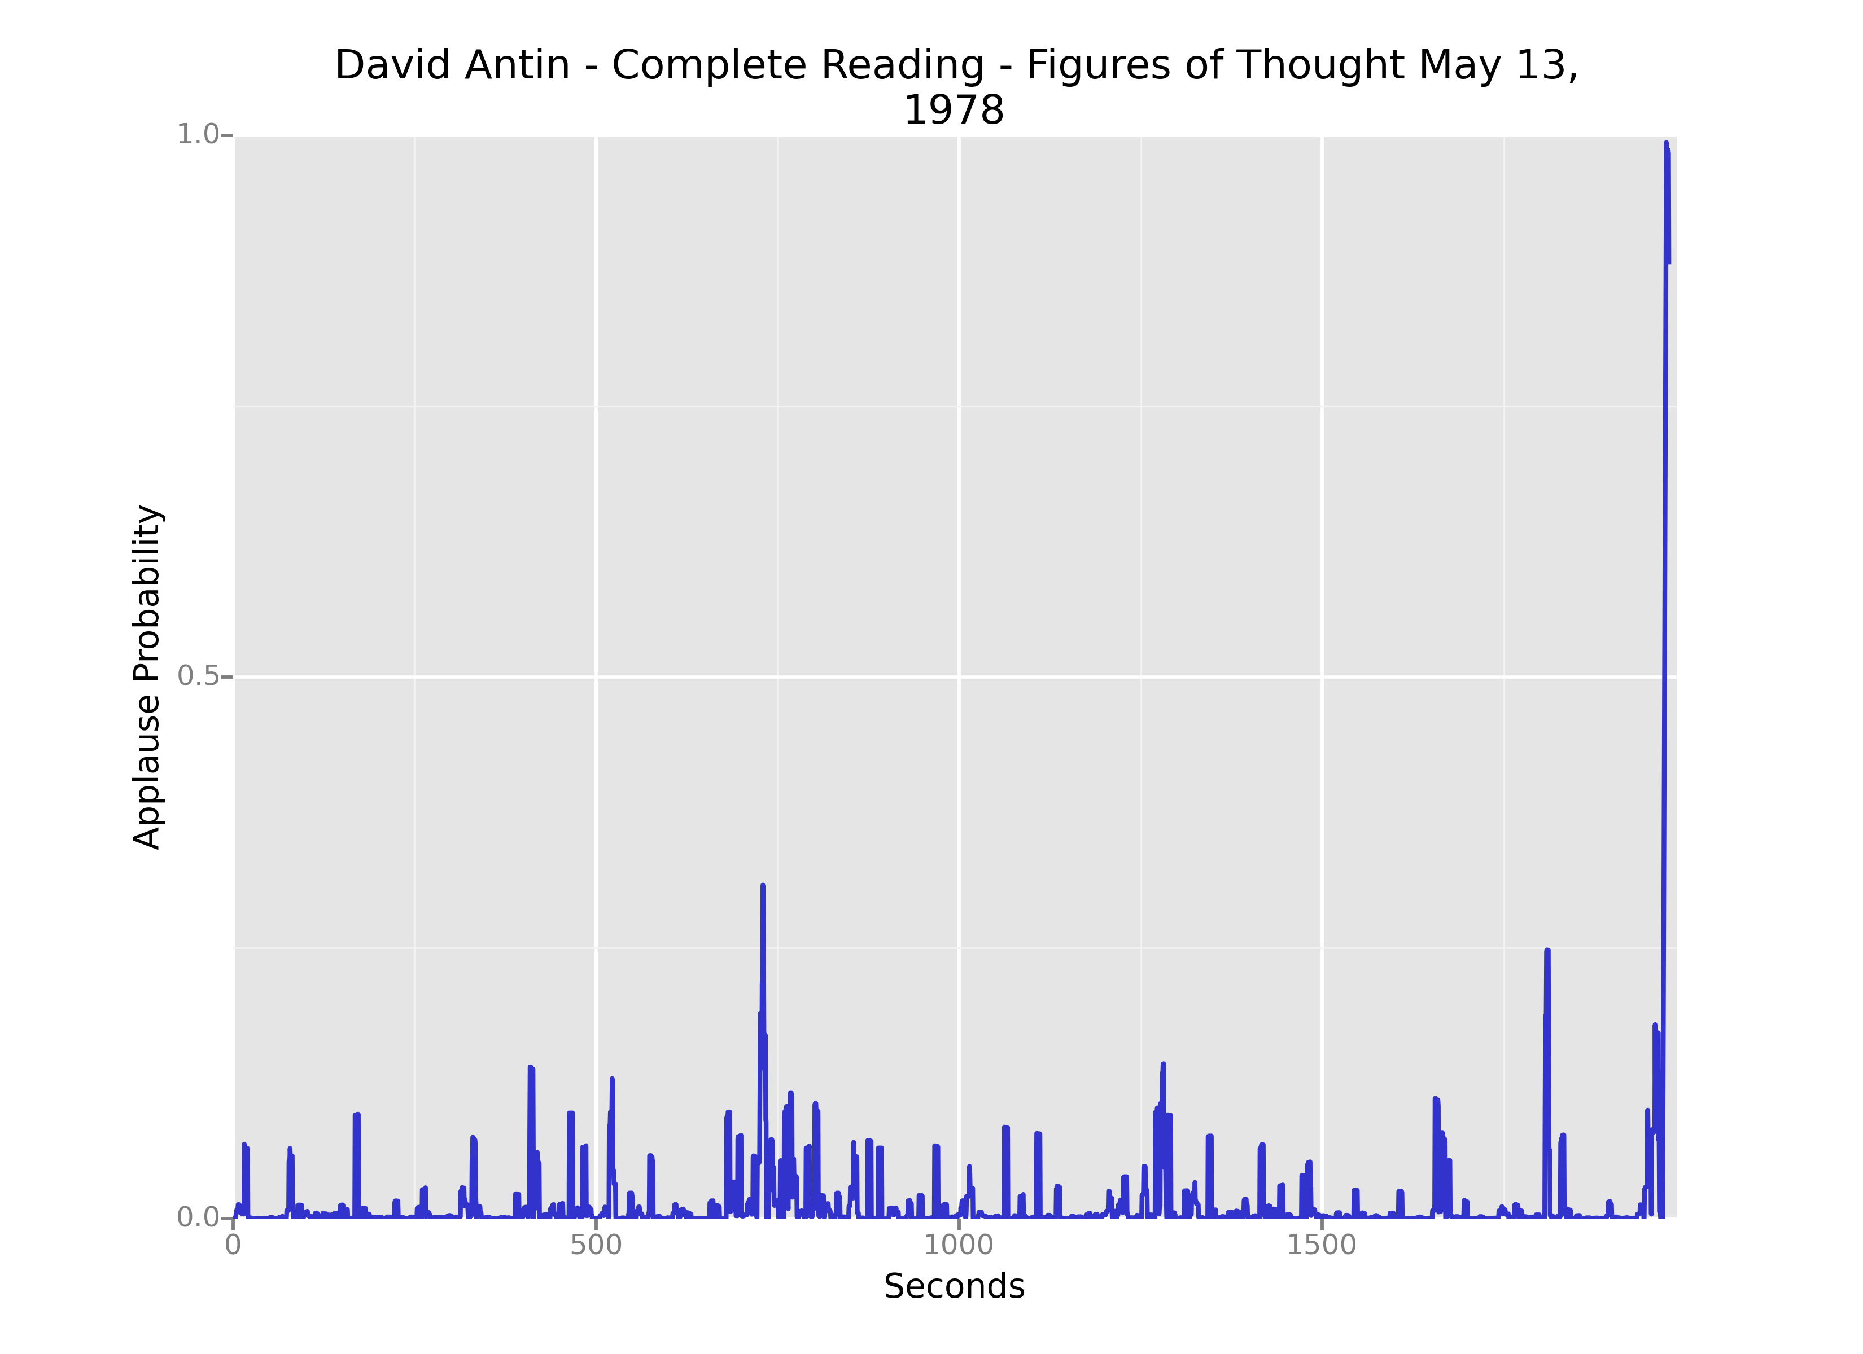
Interstitial Applause
No poem breaks

Slide 24
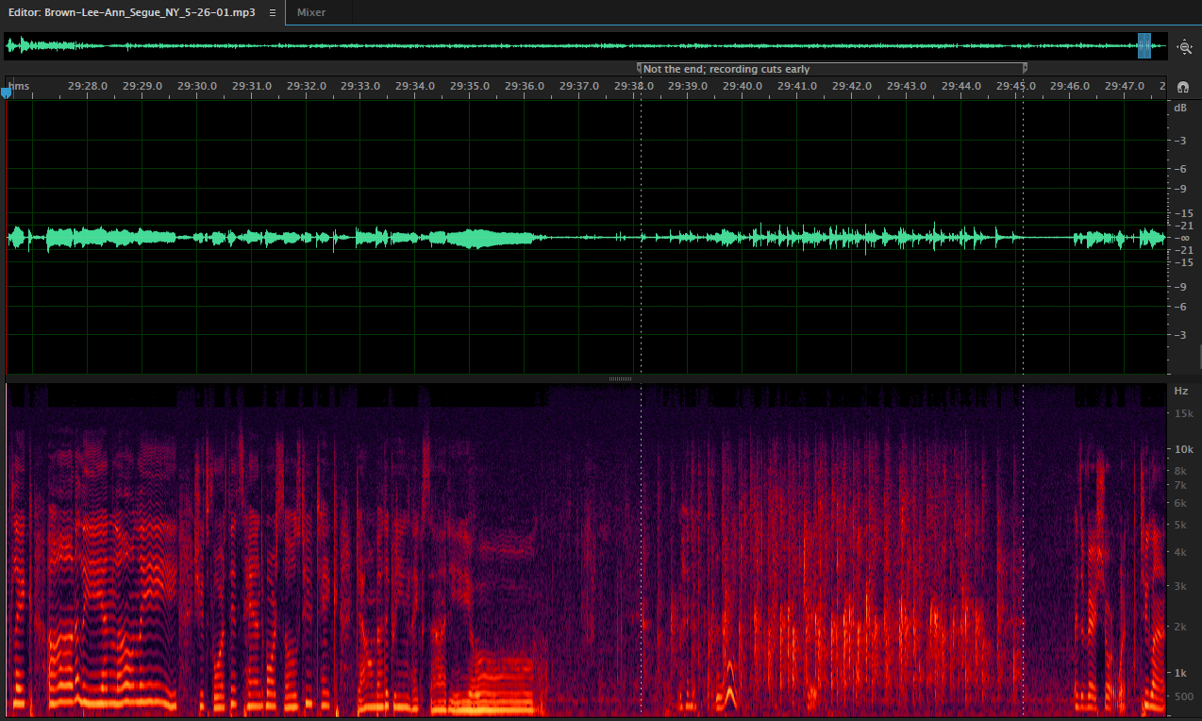
Interstitial Applause
Sung performance, gradual start

Slide 25
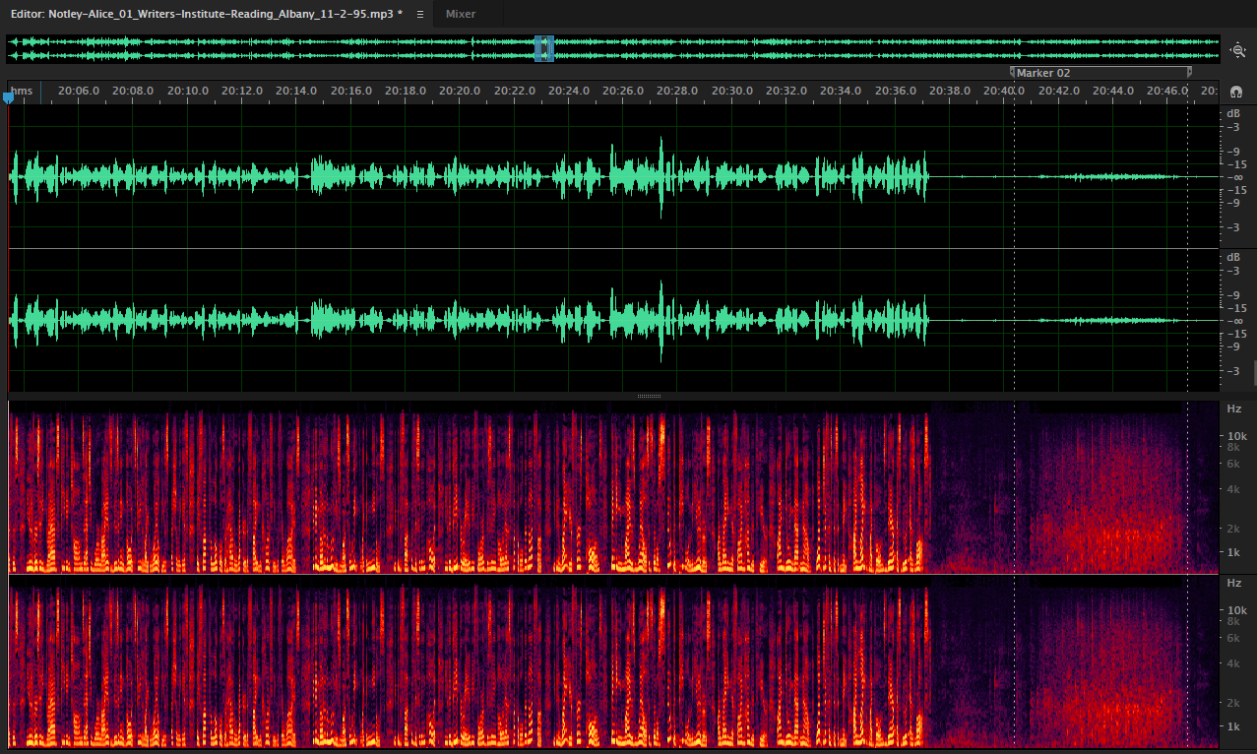
Interstitial Applause
Humor and sex, gradual start

Slide 26
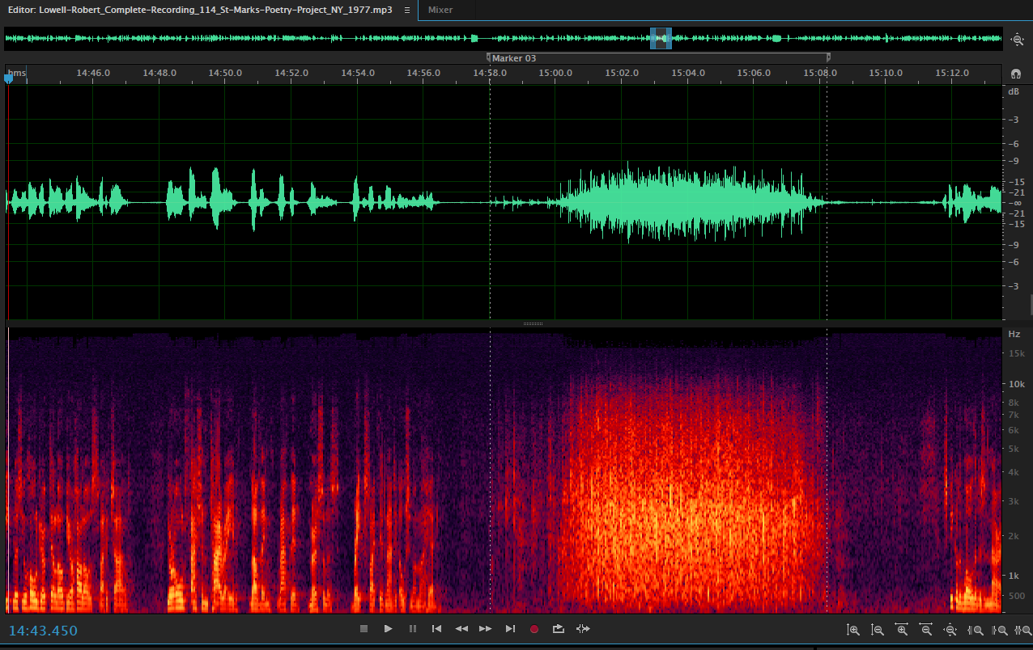
Interstitial Applause
Humor, gradual start

Slide 27
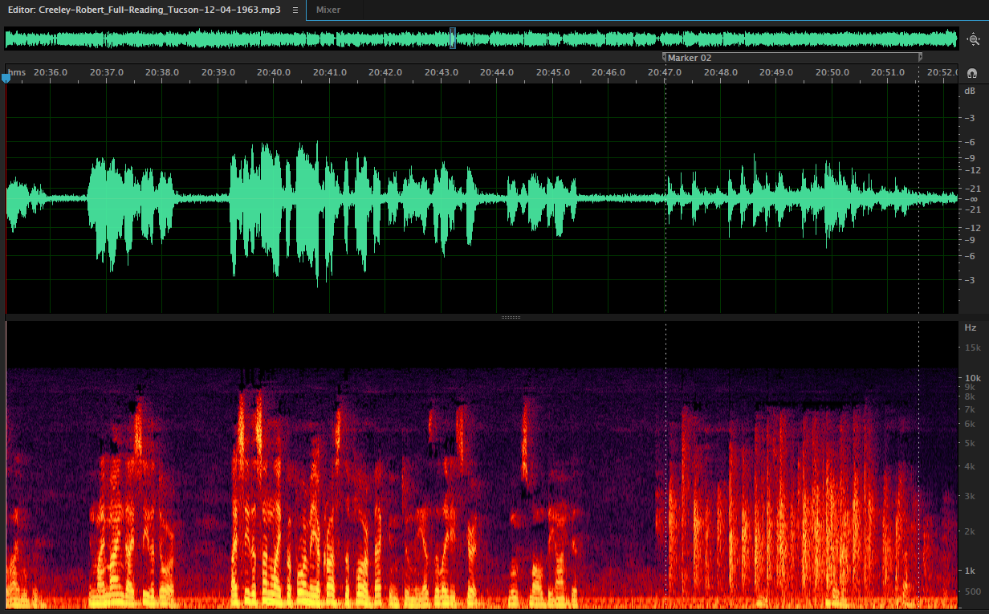
Interstitial Applause
Notable poem, attempted start

Slide 28
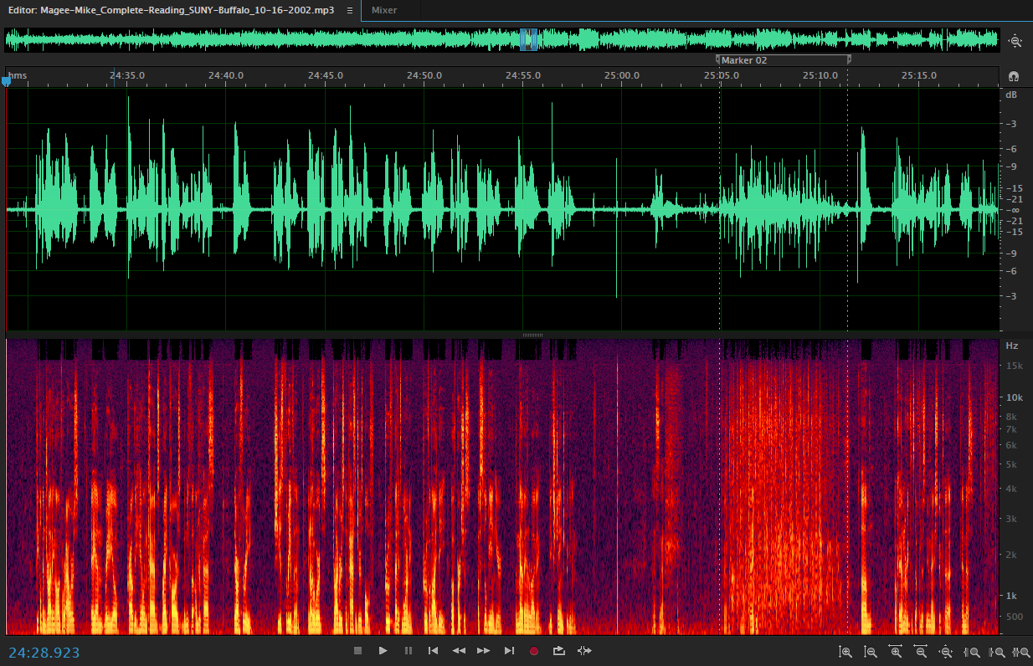
Interstitial Applause
Long poem, applause elicited

Slide 29
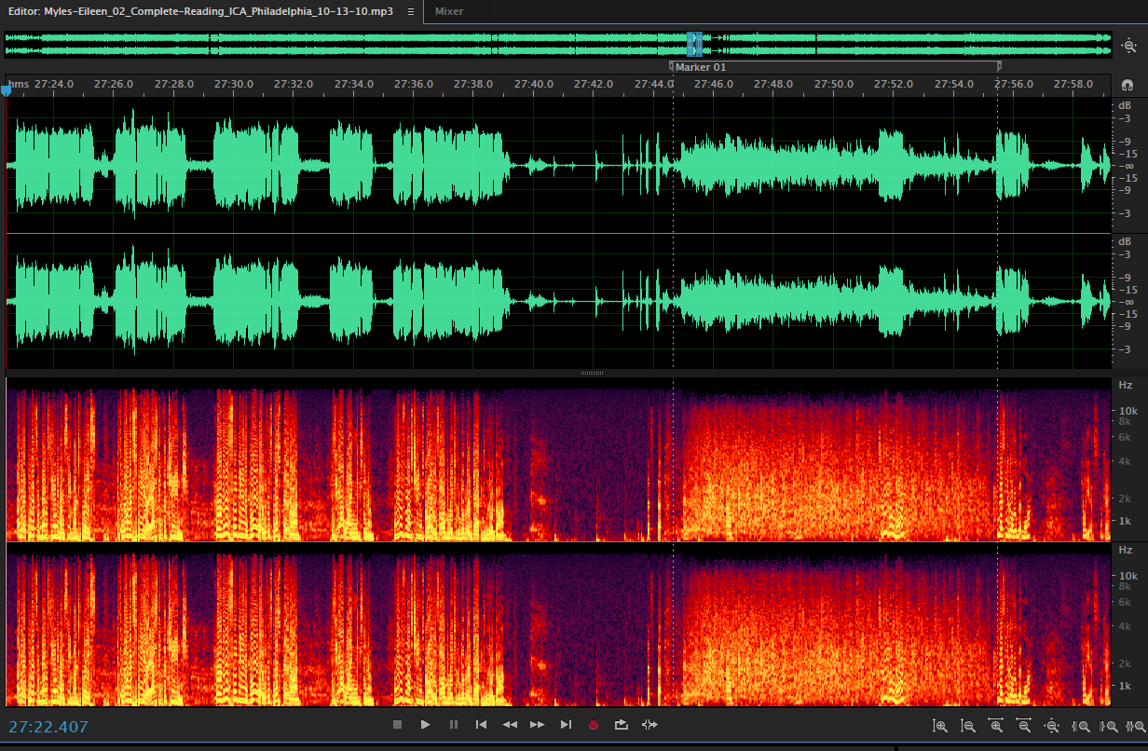
Interstitial Applause
Long poem with humor, applause elicited

Slide 30
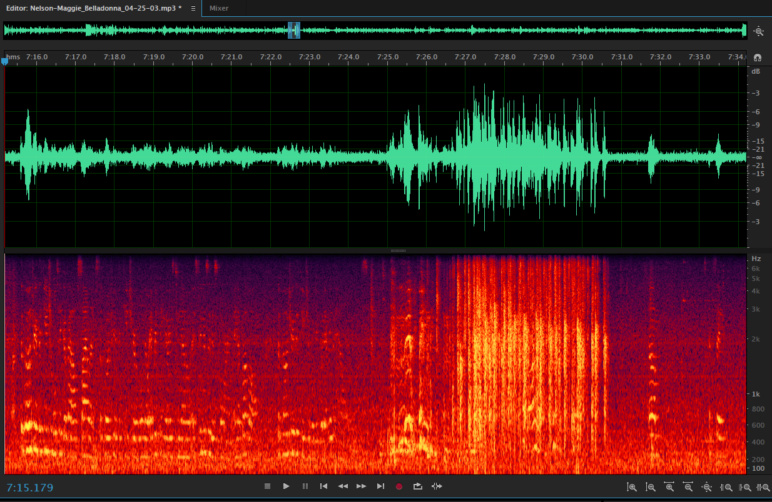
Interstitial Applause
Humor, poetic affiliation

Slide 31
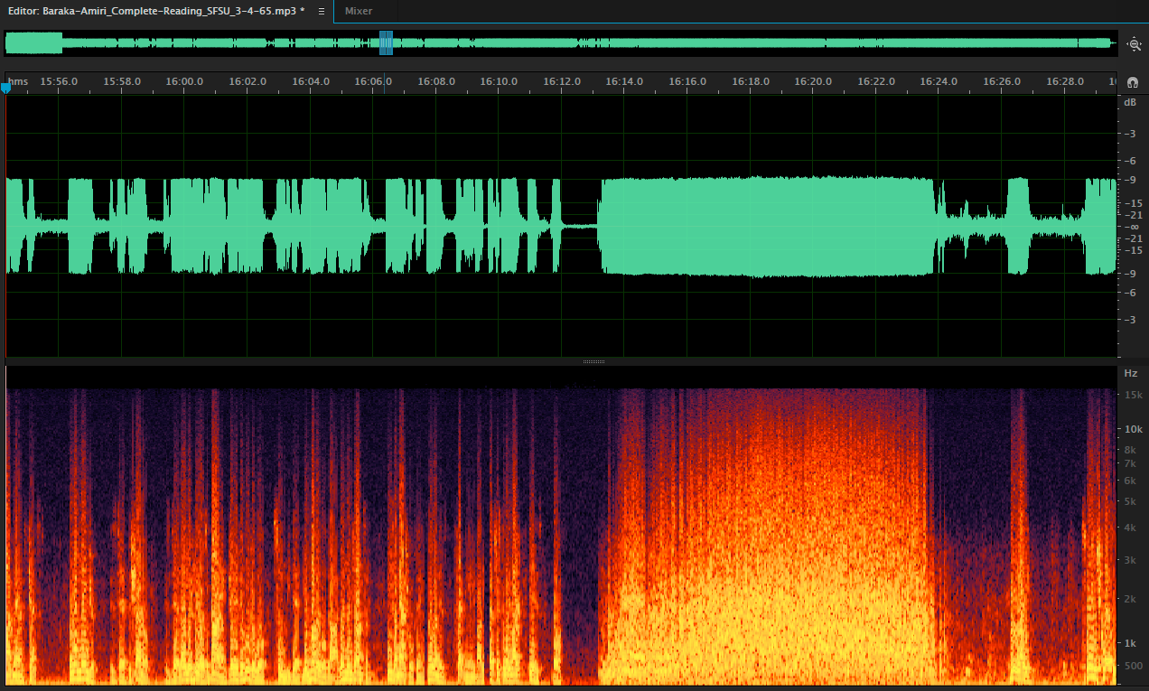
Interstitial Applause
Humor, political affiliation

Slide 32
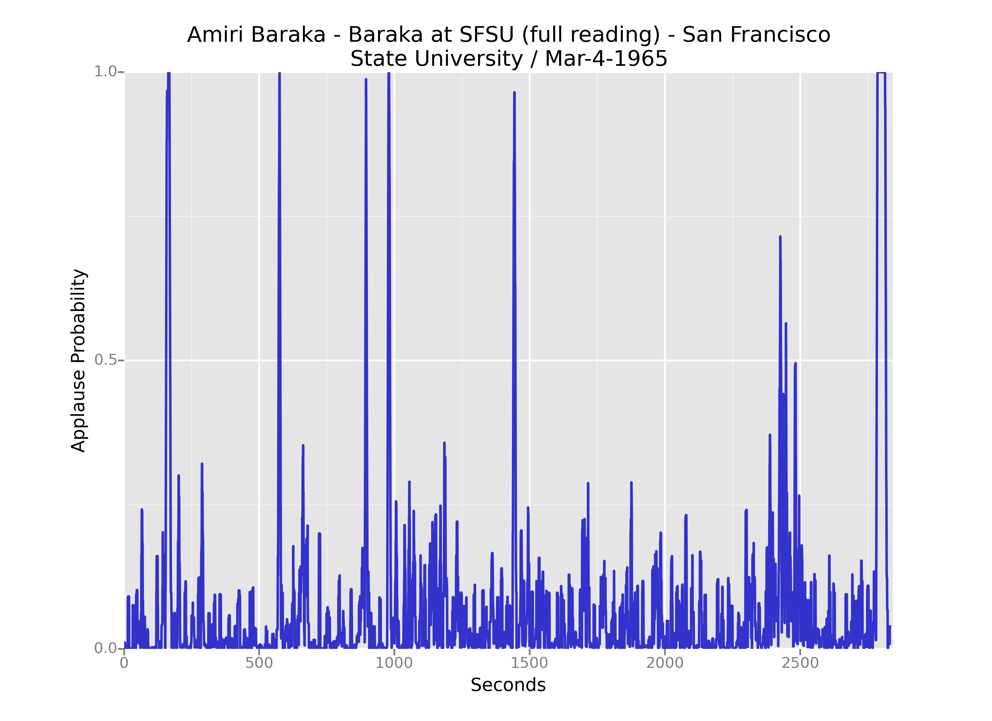
Interstitial Applause

Slide 33
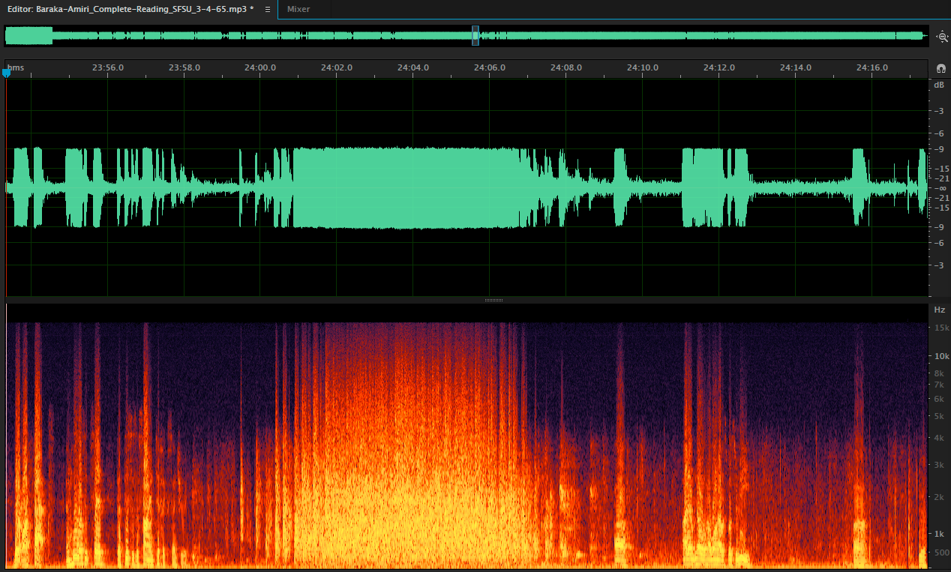
Interstitial Applause
Less marked performance, audience inertia

Slide 34
Repeated Applause Breaks

Slide 35
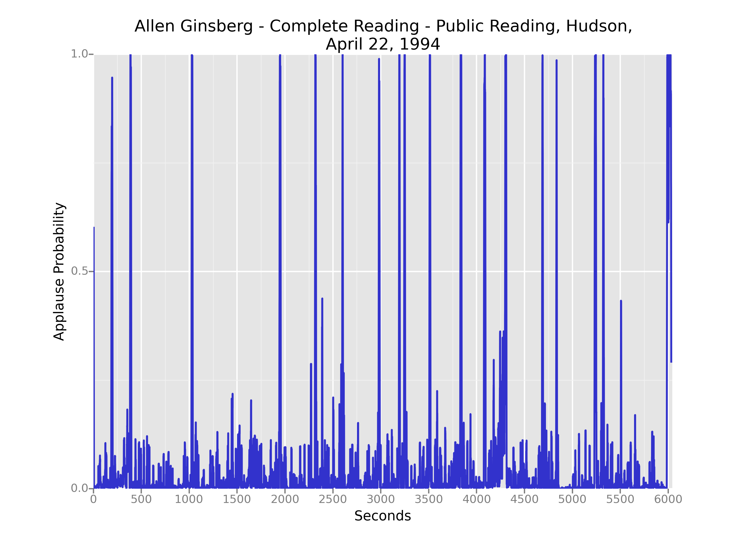
Repeated Applause Breaks

Slide 36
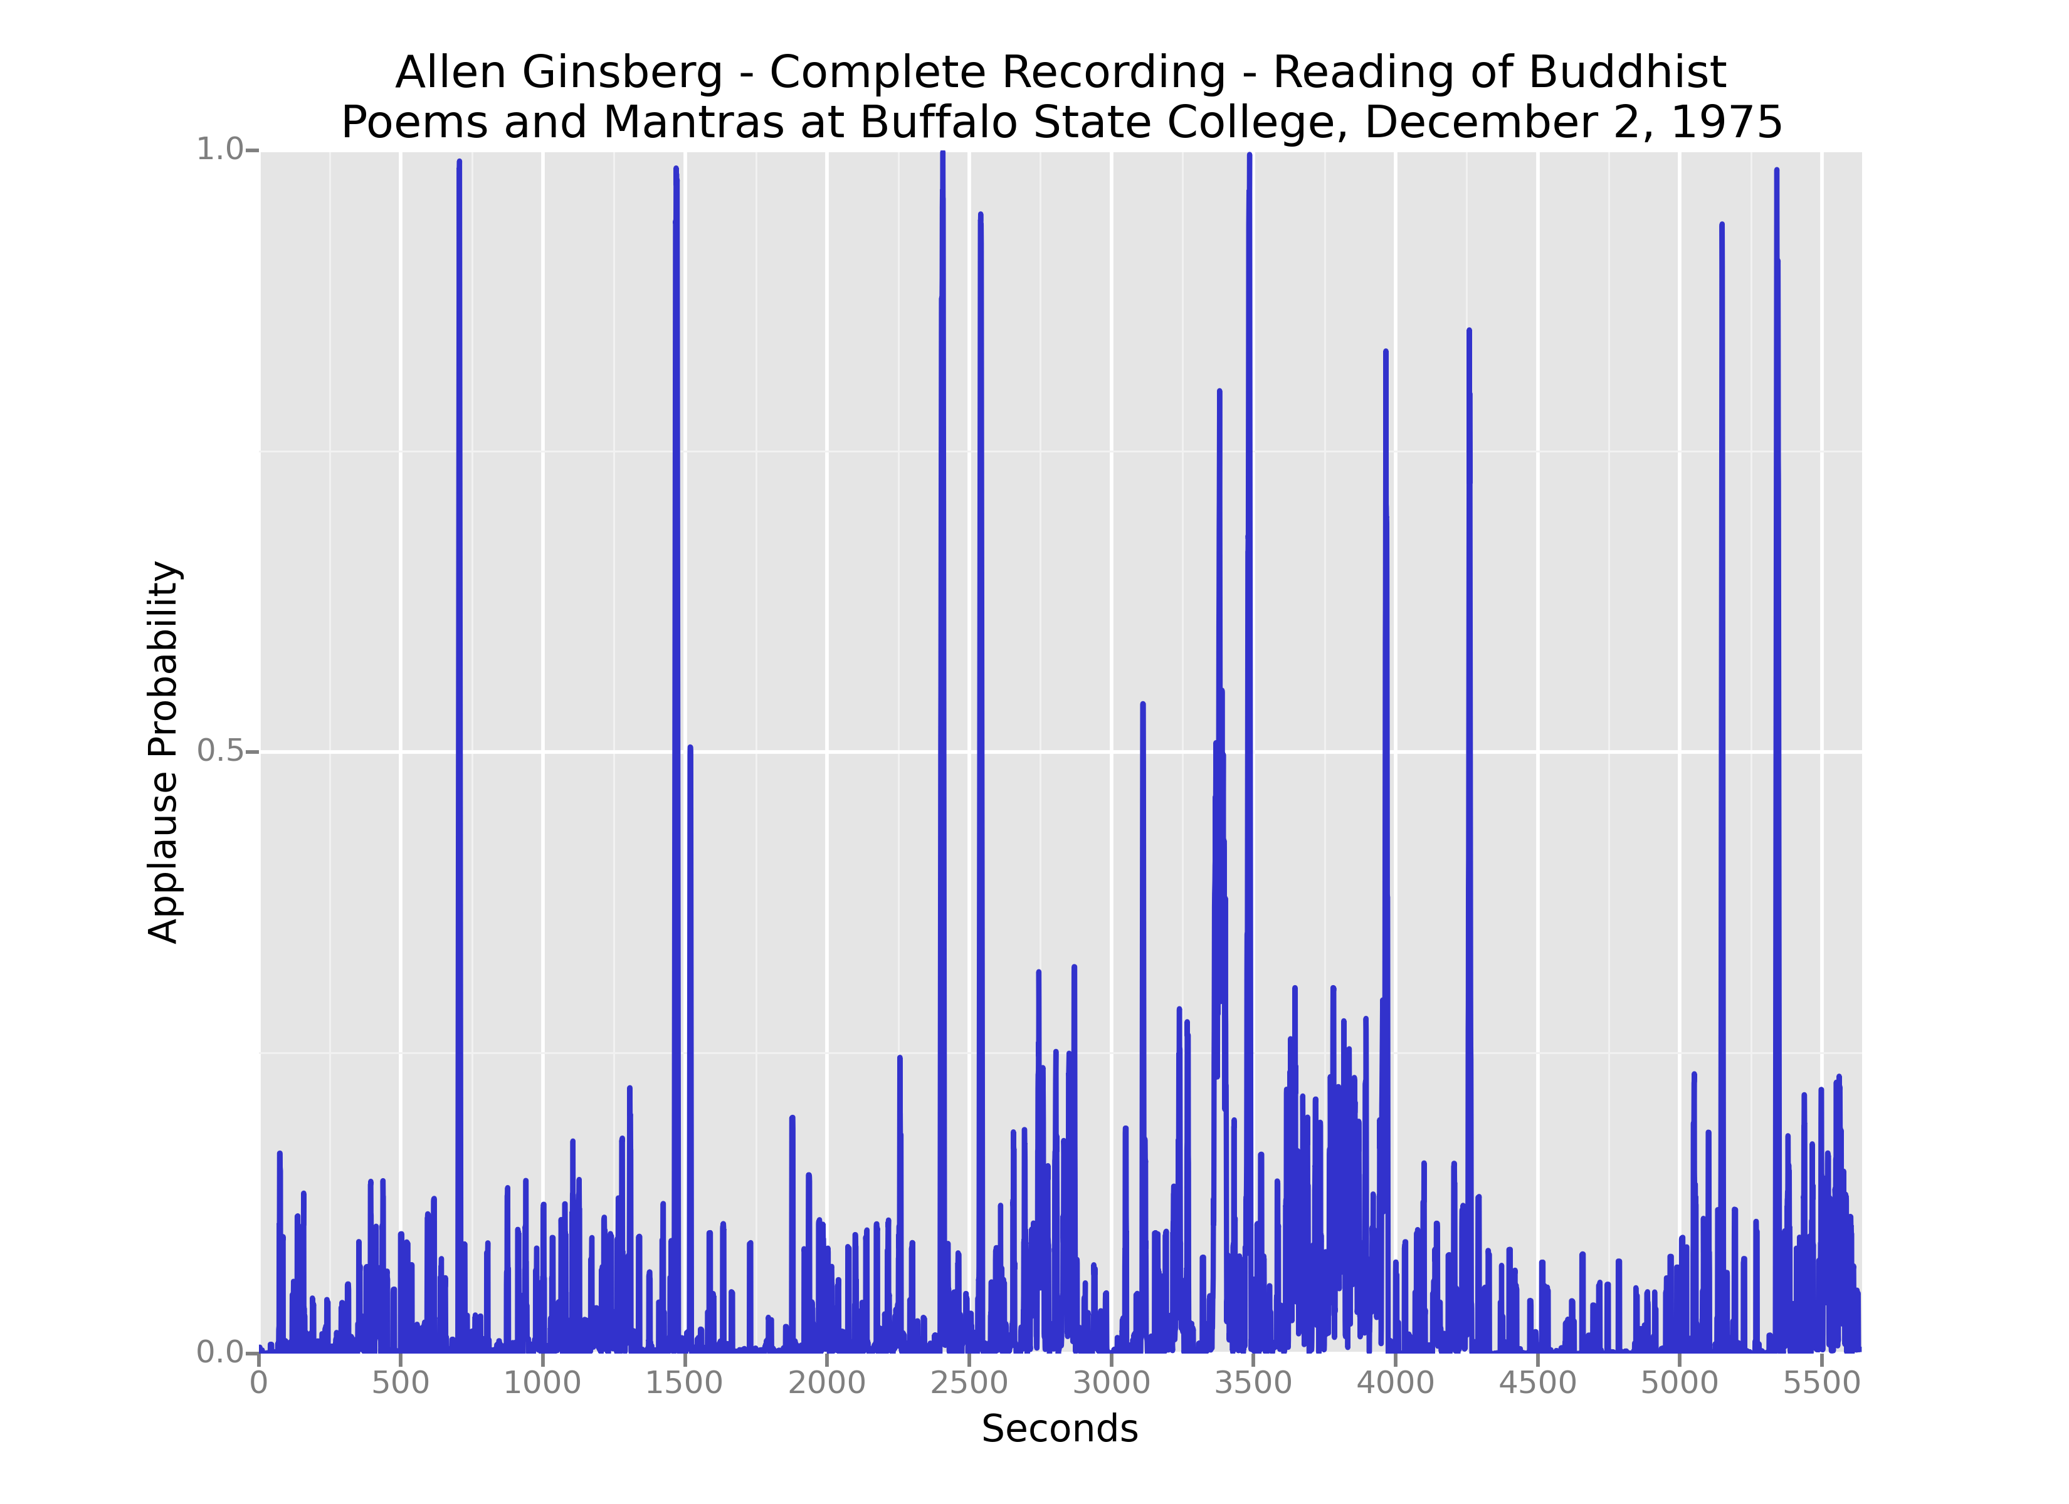
Repeated Applause Breaks

Slide 37
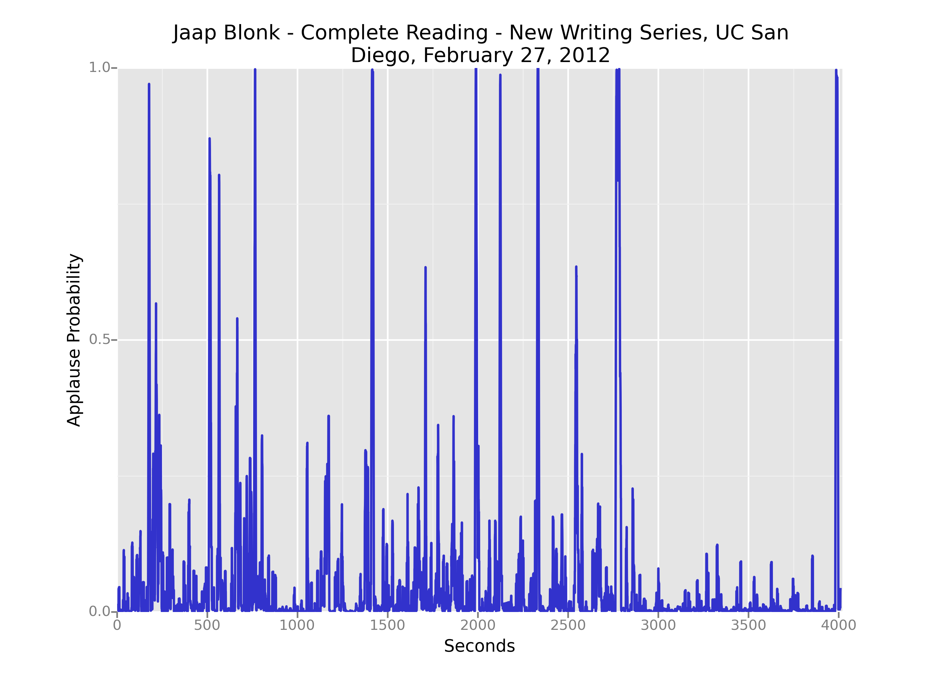
Repeated Applause Breaks

Slide 38
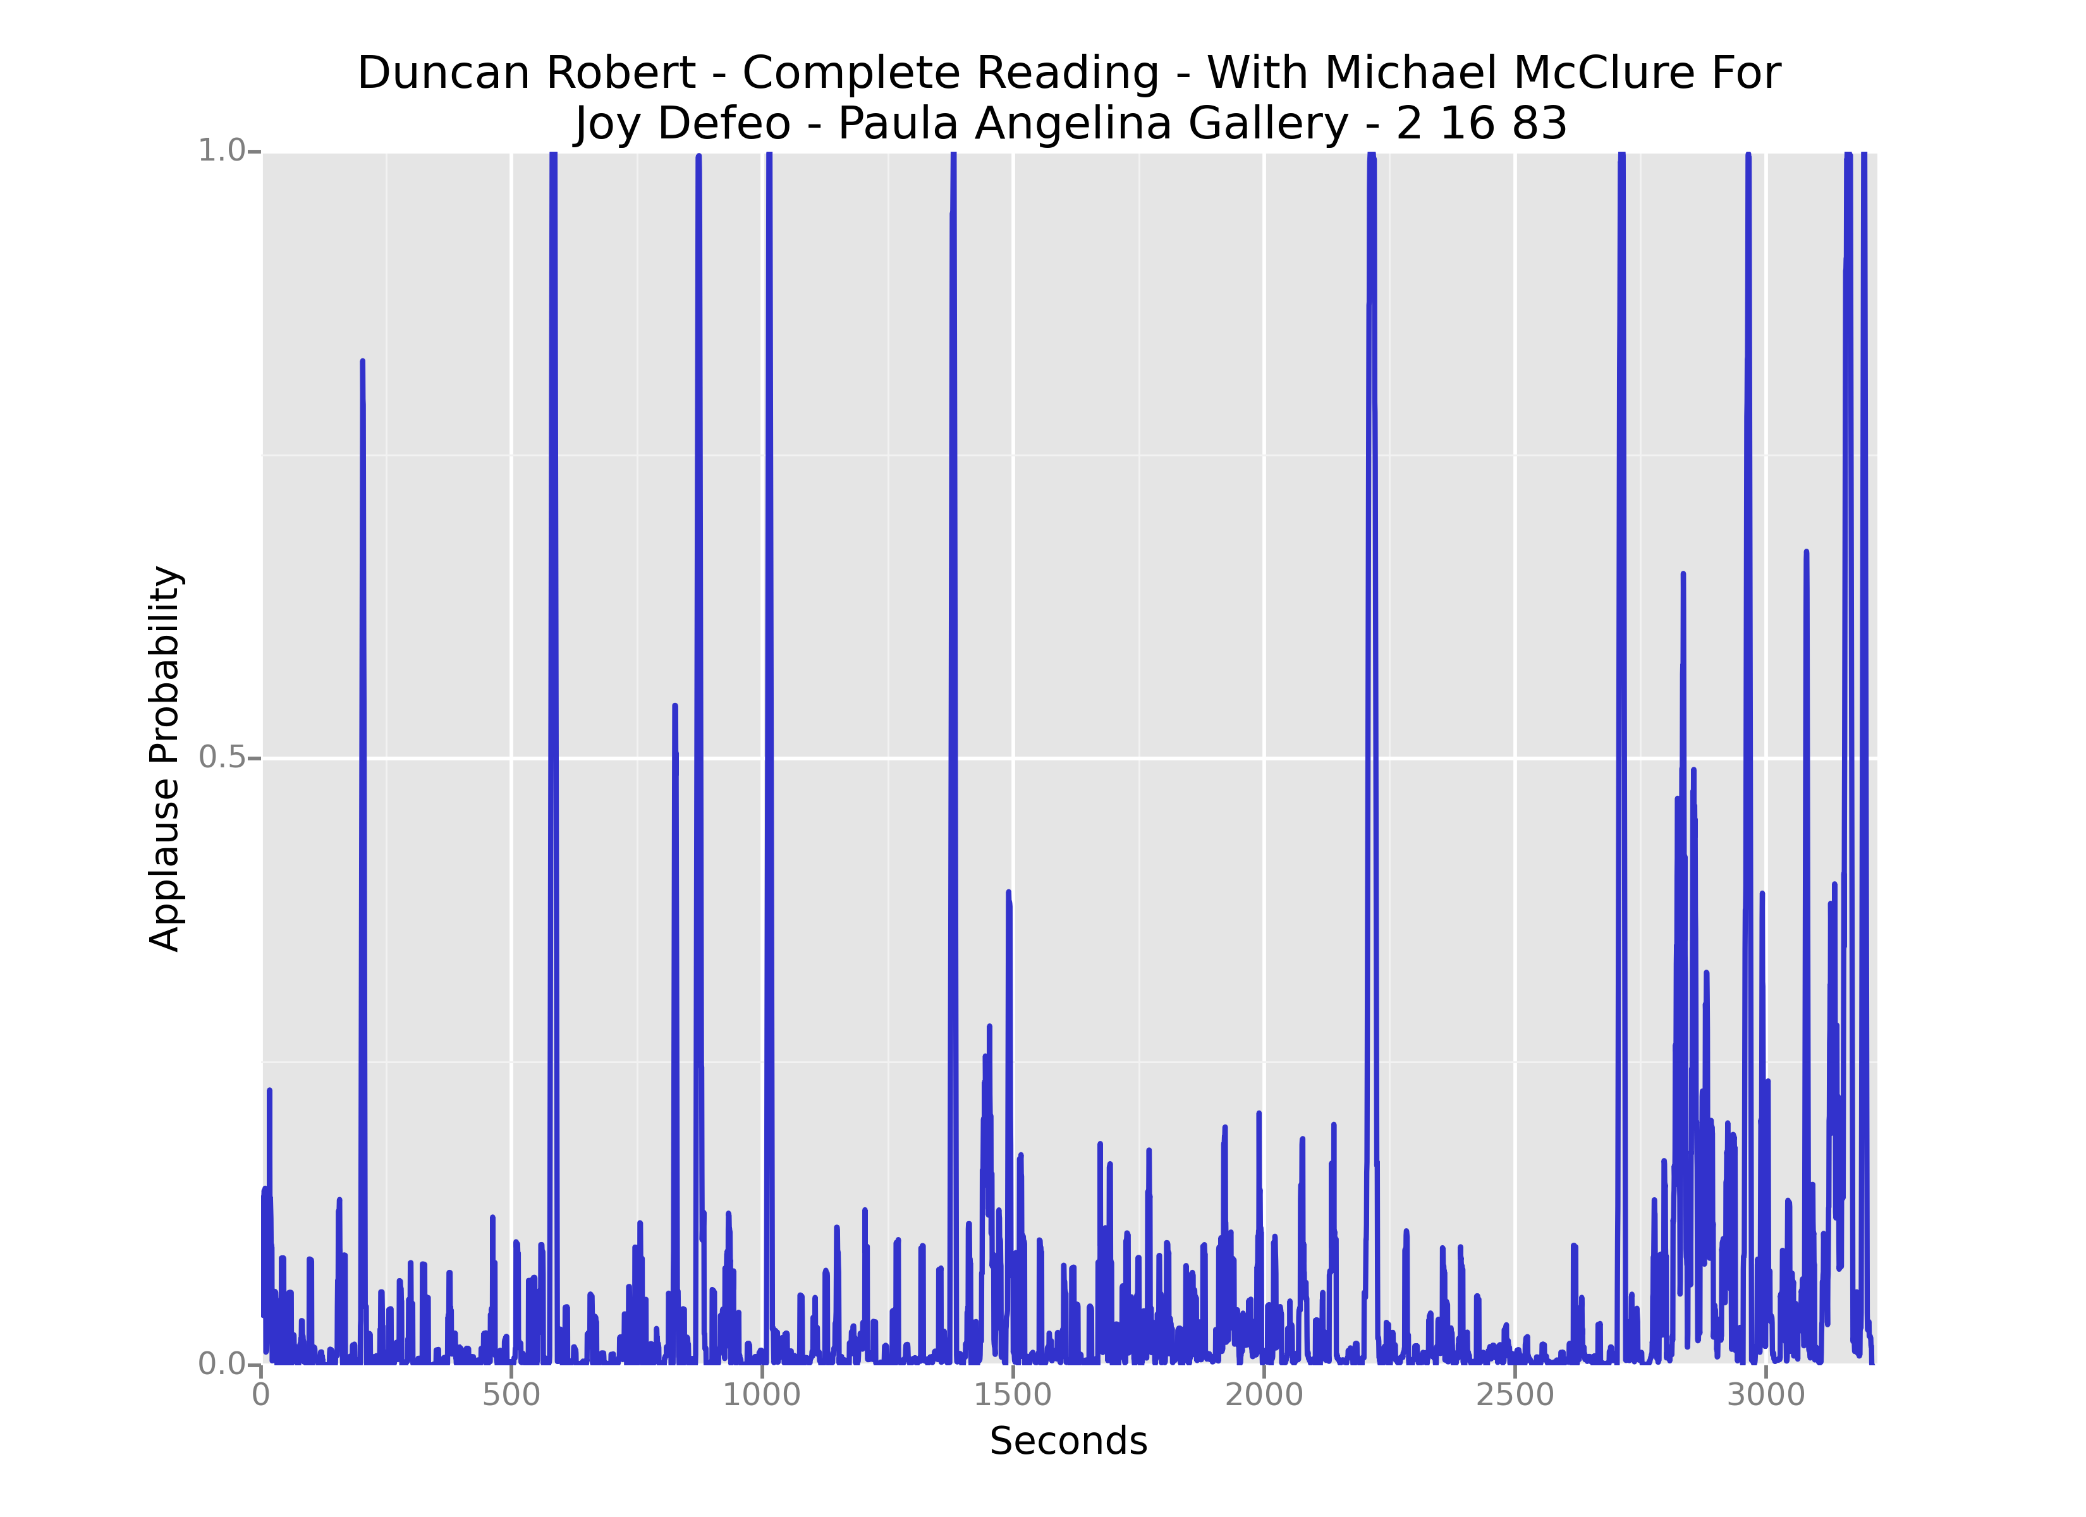
Repeated Applause Breaks

Slide 39
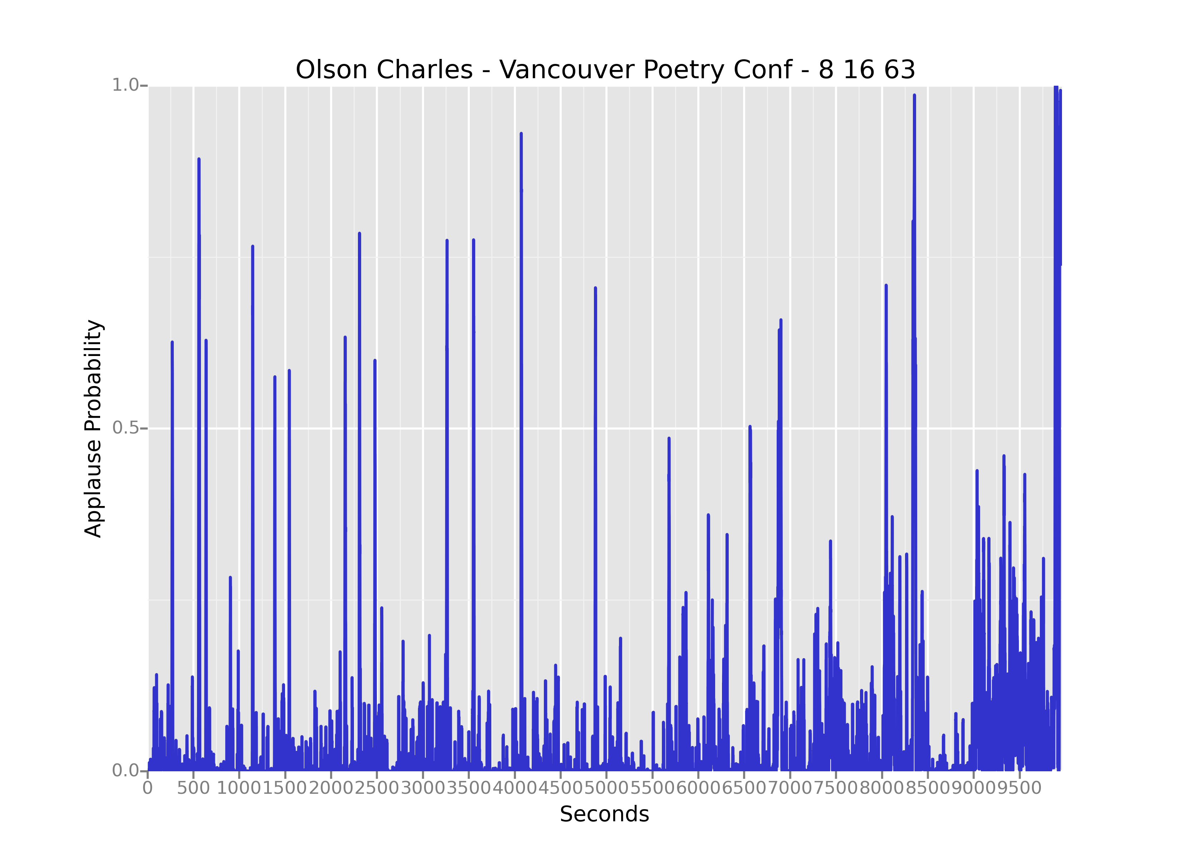
Repeated Applause Breaks

Slide 40

Bibliography
Atkinson, Max. Our Masters’ Voices: The Language and Body Language of Politics. Reprint. London: Routledge, 1992.
Bourdieu, Pierre, John B. Thompson, and Gino Raymond. Language and Symbolic Power. Reprinted. Cambridge: Harvard Univ. Press, 2003.
Duranti, Alessandro. The Voice of the Audience in Contemporary American Political Discourse. Georgetown, Georgetown University Press, 2003.
Economou, George. “Some Notes Towards Finding a View of the New Oral Poetry.” Boundary 2 3, no. 3 (1975): 653. doi:10.2307/302183.
Finnegan, Ruth H. Oral Poetry: Its Nature, Significance, and Social Context. 1st Midland Book ed. Bloomington: Indiana University Press, 1992.
Garfinkel, Harold. Studies in Ethnomethodology. Cambridge, UK: Polity Press, 1984.
Gilbert, Roger Stephen. “Joyful Noise: Reflections on Applause.” Southwest Review, no. 86 (2001): 13–33.
Gould, Glenn. “Let’s Ban Applause!” In The Glenn Gould Reader, 1st ed. New York: Knopf, 1984.
McIlvenny, Paul. “Heckling in Hyde Park: Verbal Audience Participation in Popular Public Discourse.” Language in Society 25, no. 01 (1996): 27–60.
Ramke, Bin. “James Tate’s Lost Mother.” In On James Tate, edited by Brian Henry. Under Discussion. Ann Arbor: University of Michigan Press, 2004.
Rutter, Jason. “Stand-Up as Interaction: Performance and Audience in Comedy Venues.” University of Salford, 1997.
Sacks, Harvey, and Gail Jefferson. Lectures on Conversation. Oxford, UK ; Cambridge, Mass: Blackwell, 1992.
Zumthor, Paul. Oral Poetry: An Introduction. Theory and History of Literature, v. 70. Minneapolis: University of Minnesota Press, 1990.
@stevemclaugh

